Slide 1
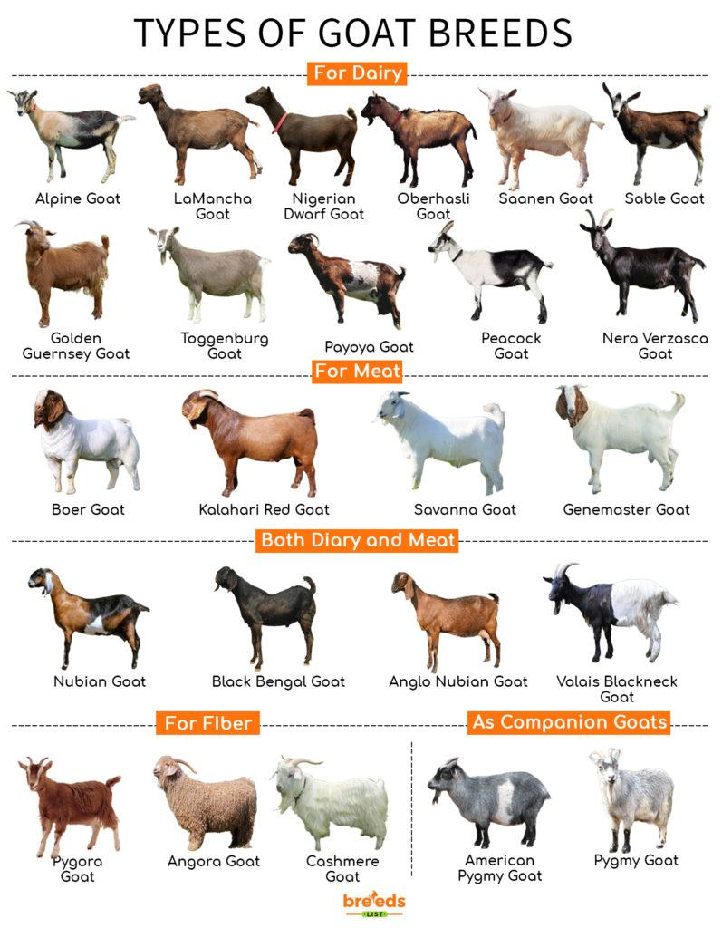
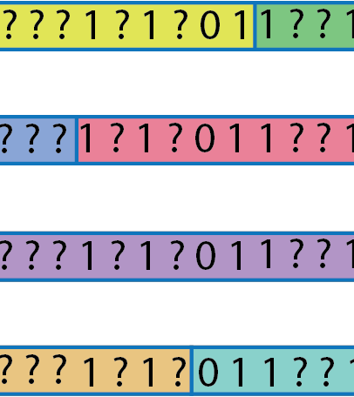
Phasing and Imputation using 1,372 diverse Goat Whole Genome Sequence Data : Optimal Strategies
VarGoats WG12 Imputation

Slide 2
Objectives of the study
The objective of the study is to develop imputation pipeline from diverse whole genome sequence (WGS) goat population data which will be used in fine mapping, meta-analysis, population genetics, and genomic prediction

Slide 3
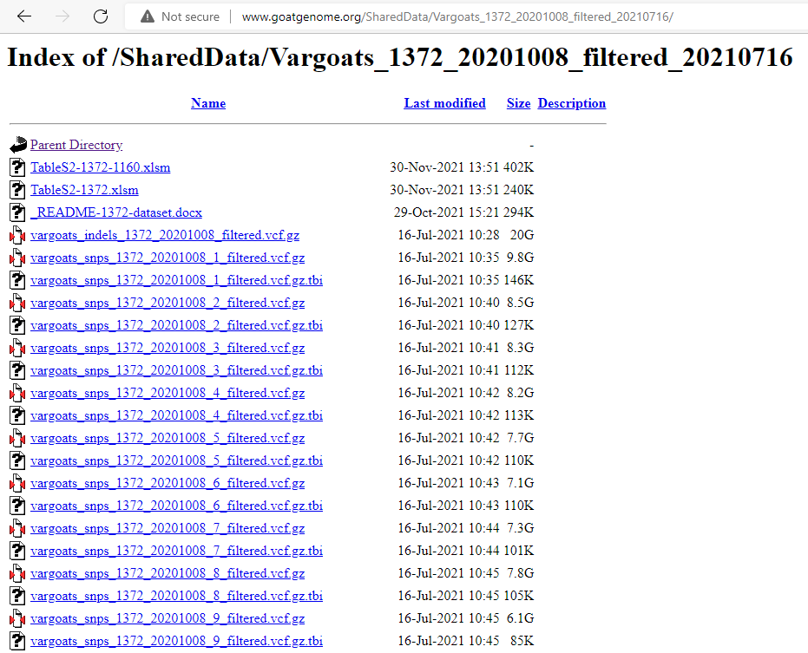
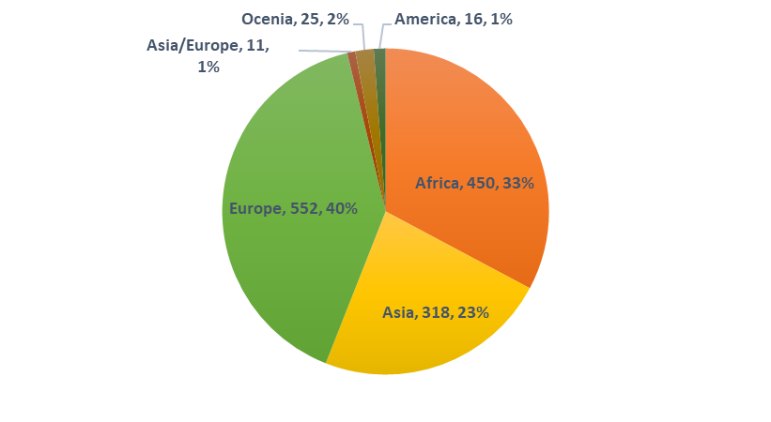
Study population (1,372 WGS samples)

Slide 4
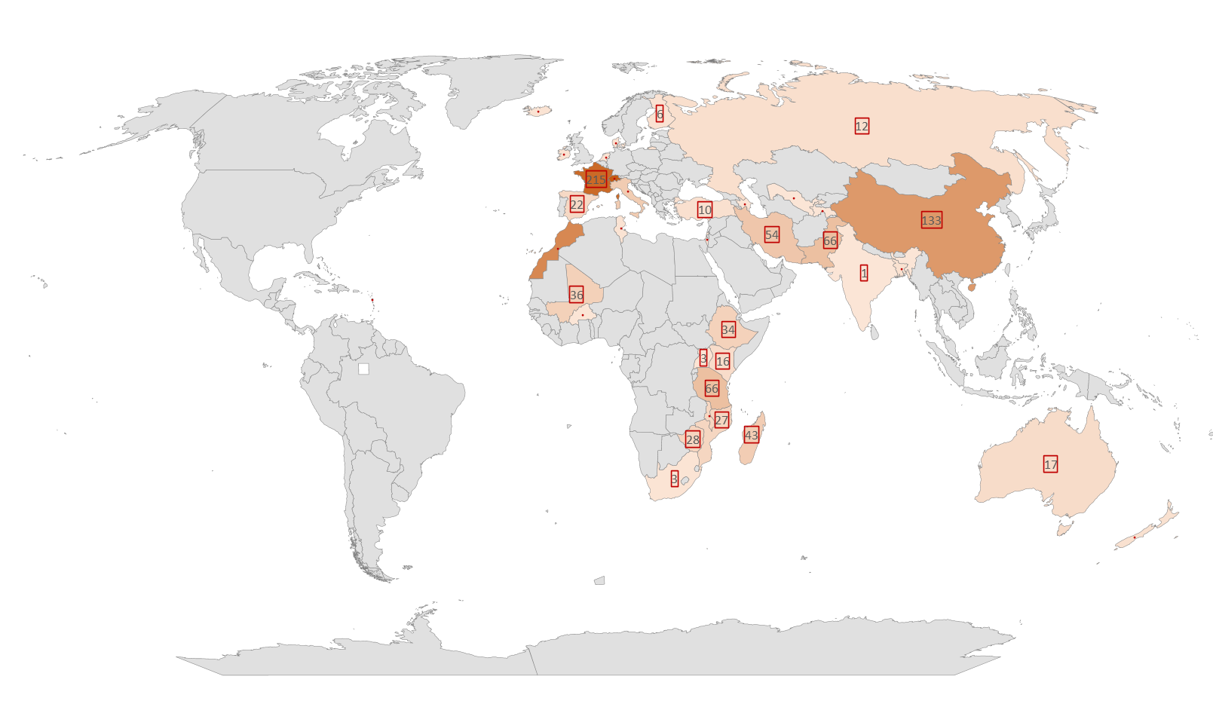
Geographical distribution of samples
Country | Number
Switzerland | 242
France | 215
Morocco | 163
China | 133
Pakistan | 66
Tanzania | 66
Iran | 54

Slide 5
Breeds
115 breeds
Saanen | 93
Alpine | 91
JiningGrey Goat | 40
Angora | 34
Boer | 34
Korea Native Goat | 27
Grisons striped | 25
Valais Goat (Blacknecked) | 25
Appenzell | 24
Booted Goat | 24
Nera Verzasca | 24
Peacock | 24
Toggenburg | 24

Slide 6
Phasing and Imputation
Phasing and imputation with Beagle 5.3
Reference sequence (vcf format) – haplotype phasing – Hidden Markov method-Baum algorithm
The Beagle 5.3 genotype phasing method is described in:
B L Browning, X Tian, Y Zhou, and S R Browning (2021) Fast two-stage phasing of large-scale sequence data. Am J Hum Genet 108(10):1880-1890. doi:10.1016/j.ajhg.2021.08.005
The Beagle 5.3 genotype imputation method is described in:
B L Browning, Y Zhou, and S R Browning (2018). A one-penny imputed genome from next generation reference panels. Am J Hum Genet 103(3):338-348. doi:10.1016/j.ajhg.2018.07.015

Slide 7
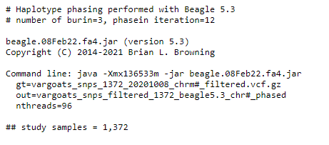

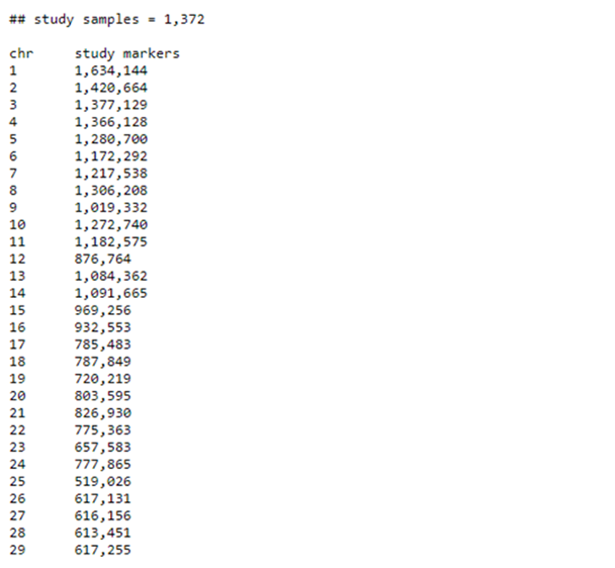
Phasing
Standard parameters are used in Beagle version 5.3
Analysis:
Computational time Chr1
Burin iteration: 20 minutes 17 seconds
Haplotype phasing time: 1 hr 2 minutes 0 seconds

Slide 8
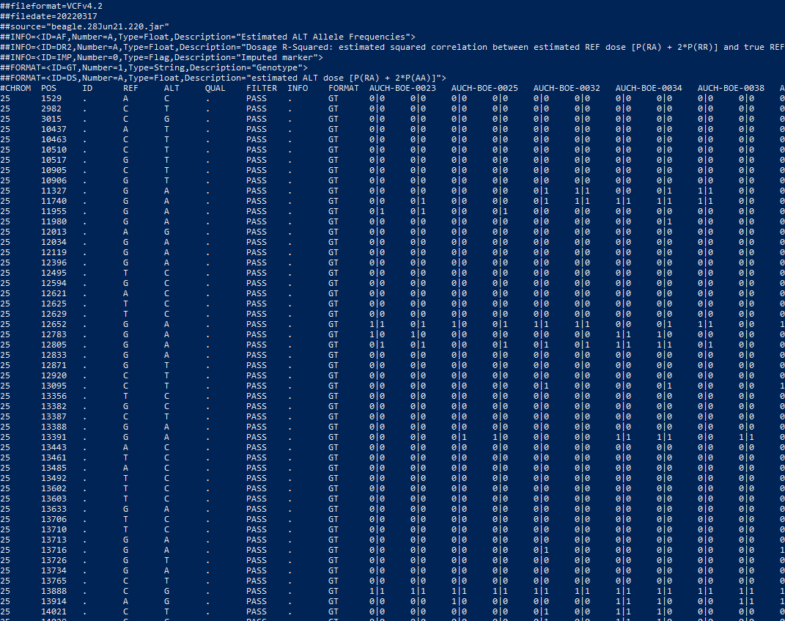
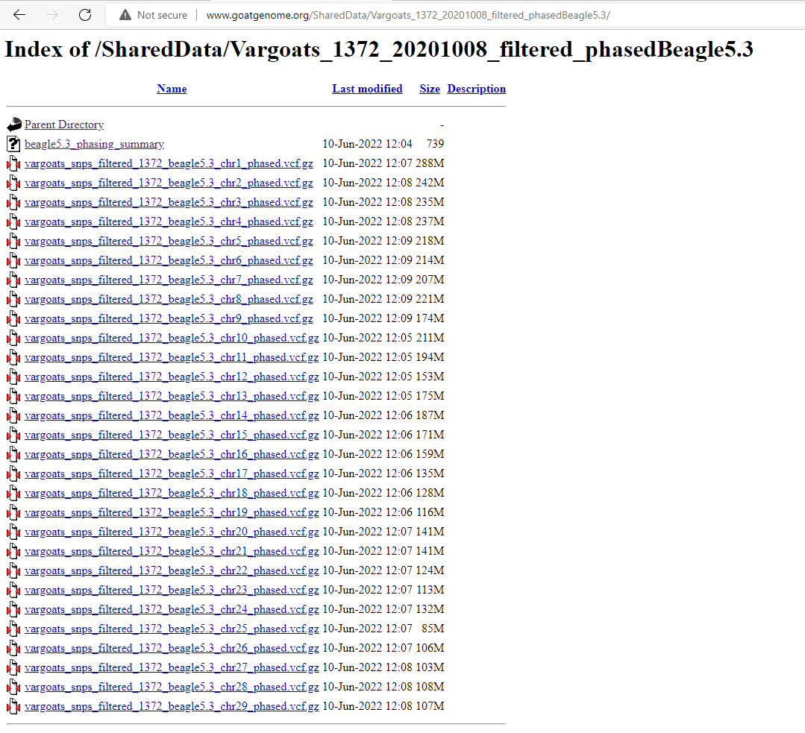
Phasing results

Slide 9
Methods (Imputation 50K to WGS), Beagle 5.3
Analysis based on
Single/major breed/closely related breed vs multibreed
region-specific (Africa, Europe, Asia) vs all regions
Dairy, goat, dairy and goat, fiber
Accuracy
Leave one out cross validation of 30 random samples (reduced to 50K and imputed back to WGS)
r2 : Can estimate when true genotypes are unknown (AGHJ 69:1-14)
Accuracy of imputation will also be accessed based on MAF to determine the accuracy for low frequency variants and at the chromosome level

Slide 10
Imputation genotypes (Data sets, ~ 50K)
Around world: 3,197 goats VarGoat (Africa, Europe, West Asia, 3 continent), Colli et al., Genet Sel Evol 50, 58 (2018)
North America: 72 goats USA (Harvey Blackburn, NAGP)
South America: 181 goats Costa Rica, Brazil, Argentina (Samuel Paiva, Brazil)
Dairy Goats: 120 USA (Ben Rosen)
Canarian goats: 224 (Palmera 61, Majorera 60, South Tinerfena 39, North Tinerfena 64), Italian Goat Consortium2 (IGC2) database
CDCB dairy goat ??
List of data from Hans

Slide 11
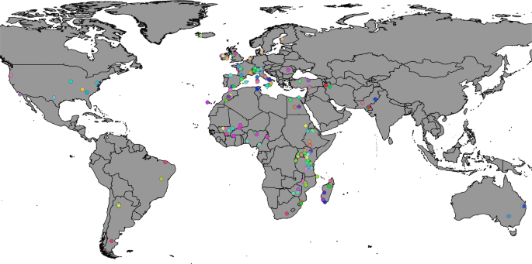
Worldwide Goats
3,197 goats with 46,654 autosomal markers
African, European, West Asian, and 3-continent
Colli et al., Genet Sel Evol 50, 58 (2018)

Slide 12
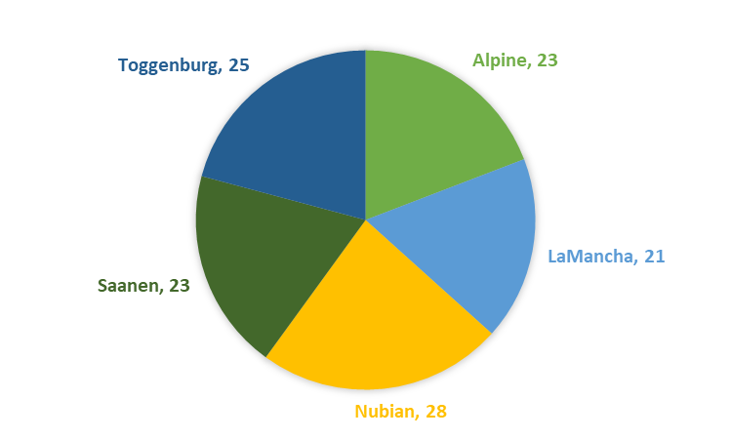
Dairy goats (USA)
120 dairy goats of 5 breeds with 46,654 autosomal markers

Slide 13
North American genotypes (72 samples of 4 breeds)
Angora | 25
Oklahoma | 1
Texas | 24
Boer | 13
Alabama | 2
NULL | 7
Oklahoma | 2
Texas | 2
LaMancha | 12
Indiana | 1
NULL | 4
Oregon | 1
Pennsylvania | 4
Washington | 2
Spanish | 22
NULL | 10
Texas | 12

Slide 14
South American samples
55 from Costa Rica, 61 from Brazil, 65 from Argentina
Costa Rica: Saanen(38) and Cruzada (17)
Brazil: Moxoto (30) and Caninde (31)
Argentina: Criollo breed with 6 differentiated breeds,
Criolla Formoseña : 14
Criolla de los Llanos: 14
Criolla Neuquina: 17
Criollo Riojana: 6
Colorada Pampeana: 14

Slide 15
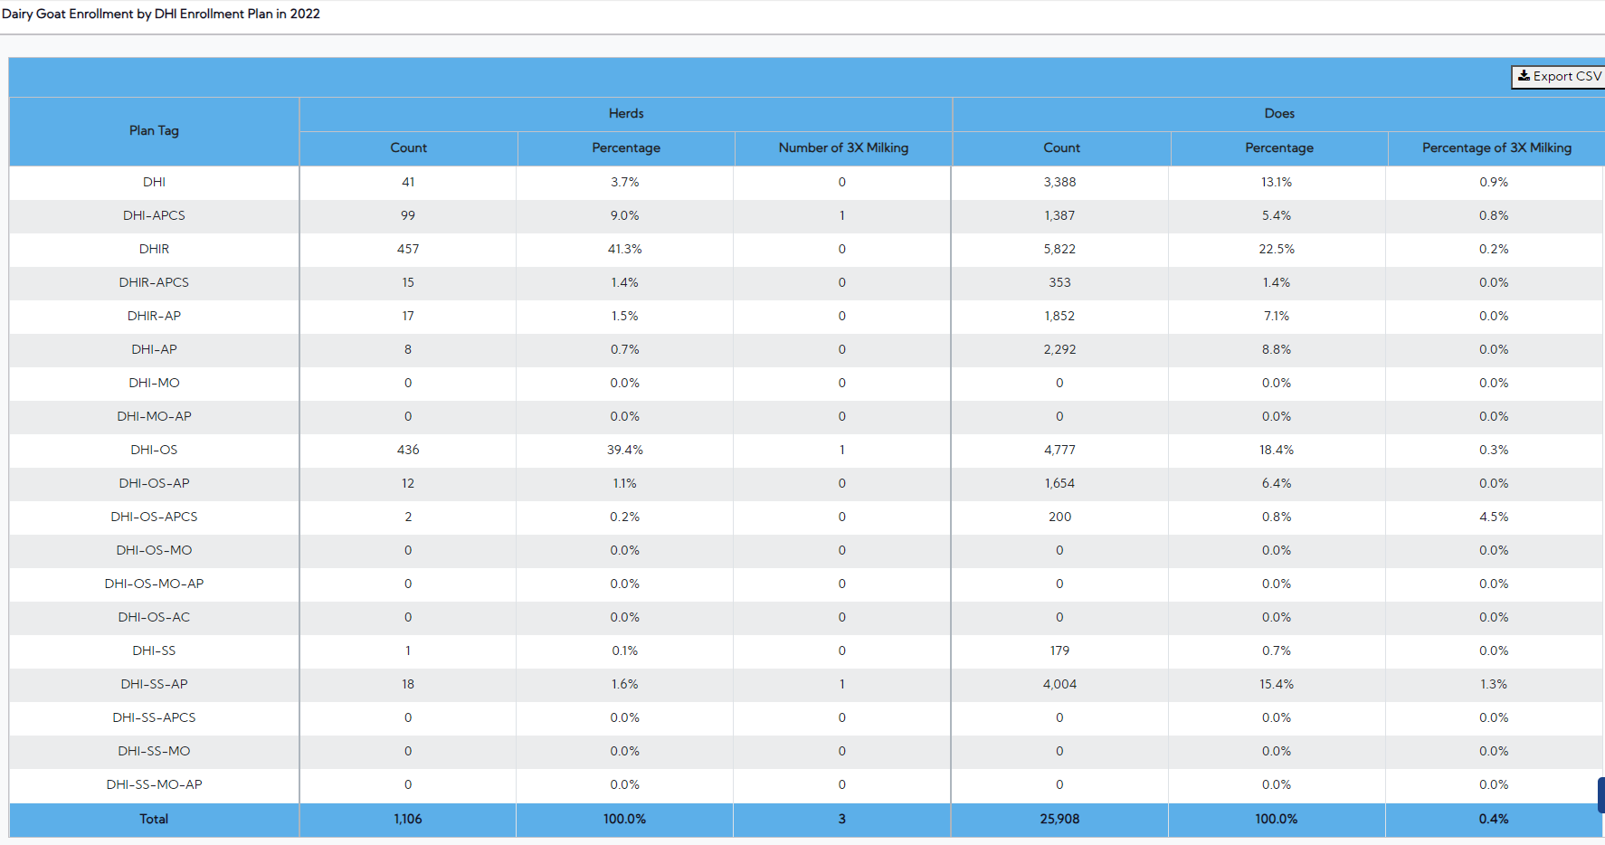
https://webconnect.uscdcb.com/#/national-performance-metrics
Notes:
https://webconnect.uscdcb.com/#/national-performance-metrics

Slide 16
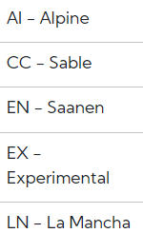
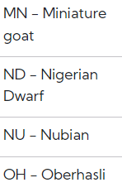
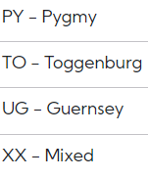
https://webconnect.uscdcb.com/#/national-performance-metrics

Slide 17
Comprehensive list provided by Hans
Data in public repositories (and also available via me)
Wild and domestic, 39 populations, 613 goats, novel data for eastern Europe and for wild goats, Pogorevc et al., 2022, DOI: 10.1111/mec.17190; data: https://figshare.com/articles/dataset/PLINK_files_ped_and_map_of_wild_and_domestic_goat_species/24190413
Italy: 331 Jonica/Siriana goats, Minozzi et al., 2023, DOI: 10.1111/age.13271; data: https://cloud.cnr.it/owncl oud/index.php/s/u8yfo XKCaI PxelQ.
Switzerland: 473 goats, 10 breeds, Burren et al., 2013, doi: 10.1111/age.12476; data: doi: 10.5061/dryad.q1cv6).
South Russia and Central Asia, 8 breeds, 237 goats, Deniskova et al., 2021, doi: 10.3389/fgene.2021.708740; data: https://figshare.com/
articles/dataset/SNP-based_genotyping_provides_insight_into_the_West_Asian_origin_of_Russian_local_goats/14706429.
Pakistan, 7 breeds, 879 goats, Moaeen‑ud‑Din et al., 2022, doi.org/10.1038/s41598-022-14018-y; data: https://figshare.com/articles/dataset/Genome_wide_association_study_identifies_novel_candidate_genes_for_growth_and_body_conformation_traits_in_goats/19668633
China: 6 breeds 193 goats, Berihulay et al., 2019, doi: 10.1111/age.12776; data: www.animalgenome.org/repository/pub/CAAS2018.1121/
Iran: 228 Markhoz goats, Nazari-Ghadikolaei et al., 2018, doi: 10.3389/fgene.2018.00105; data: https://zenodo.org/records/1198730#.WqlmbcPwZdg
Sudan, 4 breeds, 95 goats, Rahmatalla et al., 2017, DOI 10.1186/s12863-017-0553-z; data: Additional File 10
South-Africa, 8 breeds, 195 goats, Chokoe et al., doi:10.3390/su122410361; data: https://doi.org/10.5061/dryad.931zcrjnh.

Slide 18
Comprehensive list provided by Hans
Datasets I have in Utrecht for which I can ask for permission to transmit the data to you
England, Ireland: 86 Old Irish, Old English and Irish-Alpine goats. overlapping with the OIG goats in the Adaptmap and Vargoat datasets. Sean Carolan (OIG society; I already asked for permission), unpublished
Italy: 33 breeds, 1071 goats, overlapping with Adaptmap panel, Cortellari et al, (1071) https:// doi. org/10. 1038/ s41598- 021- 89900-2.
Algeria: 4 breeds, 48 goats, Ouchene-Khelifi et al., 2018, doi.org/10.1371/journal.pone.0202196.
Arapawa Island (New Zealand, 40 goats) and Percy Island (new Zealand, 30 goats) , isolated since centuries, unpublished

Slide 19
Comprehensive list provided by Hans
Other published datasets
Alpine, Saanen, 4 countries, 9855 goats. Teissier et al., 2022, doi: 10.3389/fgene.2022.862838
Angora, 3 countries, 114 goats, Visser et al., doi:10.1371/journal.pone.0154353
Norway, 3 breeds, 96 goats, Berg et al., 2020, doi.org/10.1080/09064702.2020.1729852
Greece, 2 breeds, 72 goats, Michailidou., 2019, doi.org/10.1371/journal.pone.0226179
China, 2 breeds, 239 goats, Wang et al., 2022, https://doi.org/10.1093/jas/skac274
China, 4 breeds, 96 goats, Zhong et al., 2023, doi.org/10.1016/j.animal.2023.100706
India, 15 breeds, 225 goats, Kumar Vijh et al., doi.org/10.1016/j.gene.2023.147691, Axiom HD array
Mongolia, 5 breeds, 167 goats, Kukhina et al., 2021, doi.org/10.3390/ani12030221
Ethiopia, 13 breeds, 664 goats, Tarekegn et al., 2020, DOI: 10.1111/eva.13118
Uganda, 6 breeds, 144 goats, Onzima et al., 2018, doi: 10.1111/age.12631
South Africa, 4 breeds, 144 goats: Monau et al. 2020, doi.org/10.1007/s11250-019-02190-9
South Africa, 4 breeds, 72 goats, Mcube et al., 2020, doi.org/10.1007/s11250-019-02128-1
Canada, 6 breeds, 976 goats, Brito et al., 2015, DOI 10.1186/s12863-015-0220-1
Australia, 3 breeds, 175 goats, Kijas et al., 2012, doi: 10.1111/age.12011

Slide 20
Outcome
Pipeline and scripts on GitHub repository
https://github.com/goatimpuation/GoatWGSimputation
Population genetics, fine mapping, meta-analysis, and genomic prediction
Additional samples will be helpful in imputation of breeds currently underrepresented in the analysis (breeds from India, South America, and North America)
Incorporation of pedigree/family information will be useful for long-range haplotype-based imputation using findhap.f90

Slide 21


Acknowledgements
VarGoats
(https://www.goatgenome.org/vargoats.html)
SCINET Ceres Scientific computing
(https://scinet.usda.gov)

Slide 22
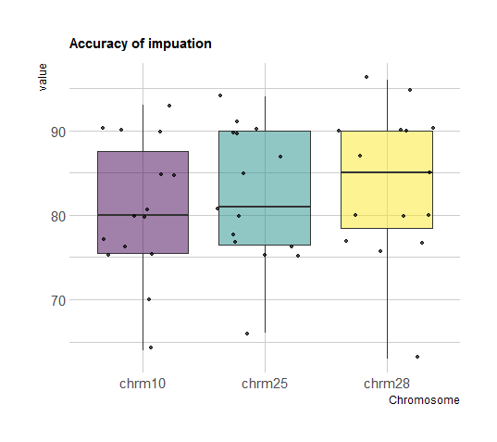
Imputation accuracy (Beagle)
Notes:
More iteration and average of iterations, look into low accuracy samples as it tells you more about influence of reference population (breed, location, type). Old analysis, improving with tweak in parameters

Slide 23
Imputation accuracy is a function of MAF

